Slide 1

Project Title –
AI-Based Network Intrusion Detection System (AI-NIDS)
[Student Name – Adarsh Kumar Tiwari ]
[AICTE ID :STU6839f5a30695a1748628899 ]

Slide 2

PROBLEM STATEMENT
Modern computer networks face a large number of cyber-attacks such as DDoS, brute force, and malicious traffic.
Traditional intrusion detection systems are rule-based and fail to detect new or complex attack patterns.
There is a need for an intelligent, automated, and explainable system that can:
Detect network intrusions accurately
Classify traffic as benign or malicious
Help students understand why a packet is marked as an attack

Slide 3
Project Description
This project implements an AI-Based Network Intrusion Detection System (NIDS) using Machine Learning and AI explanation.
Key highlights:
Uses Random Forest Classifier to detect network attacks
Trained on real-world CIC-IDS DDoS dataset
Built using Streamlit for an interactive dashboard
Integrates Groq AI (LLAMA model) to explain packet behavior in simple language
Simulates live packet capture for learning and demonstration
The system helps students and beginners understand how ML detects cyber-attacks.

Slide 4

WHO ARE THE END USERS?
Cybersecurity Students
Computer Science Students
Beginners learning Network Security
Academic Researchers
Faculty for demonstrations
Training & Internship Programs

Slide 5

Technology Used
Programming Language: Python
Frontend: Streamlit
Machine Learning Algorithm: Random Forest Classifier
Libraries Used:
Pandas
NumPy
Scikit-Learn
AI Explanation Engine: Groq API (LLAMA-3.3-70B Model)
Dataset: CIC-IDS DDoS CSV Dataset
Platform: Web-based Application

Slide 6
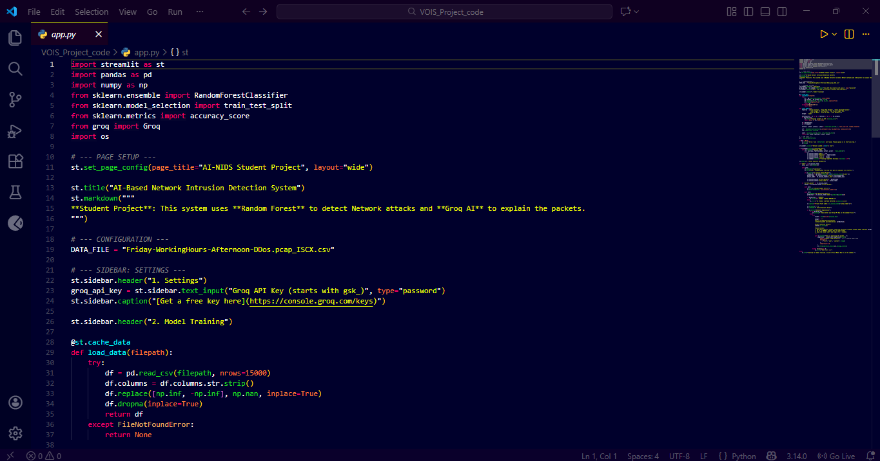
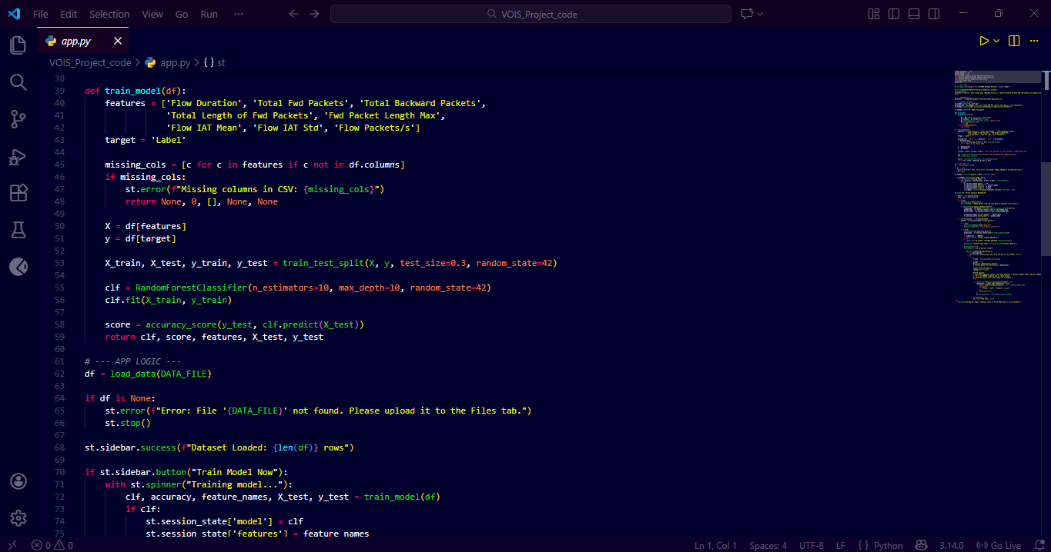
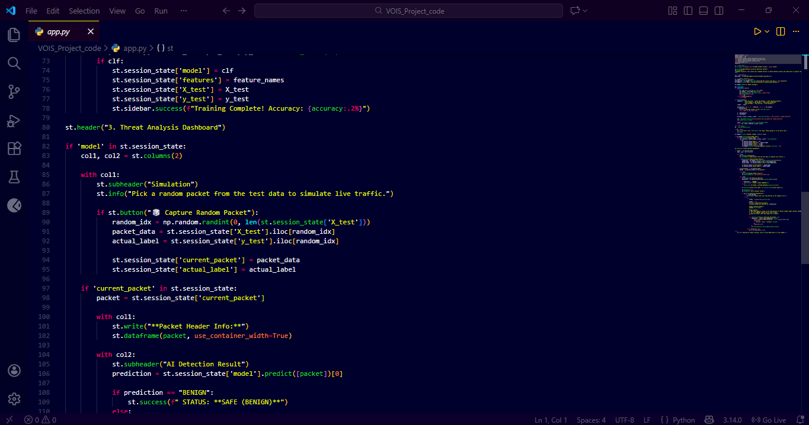
RESULTS
Demo Link

Slide 7
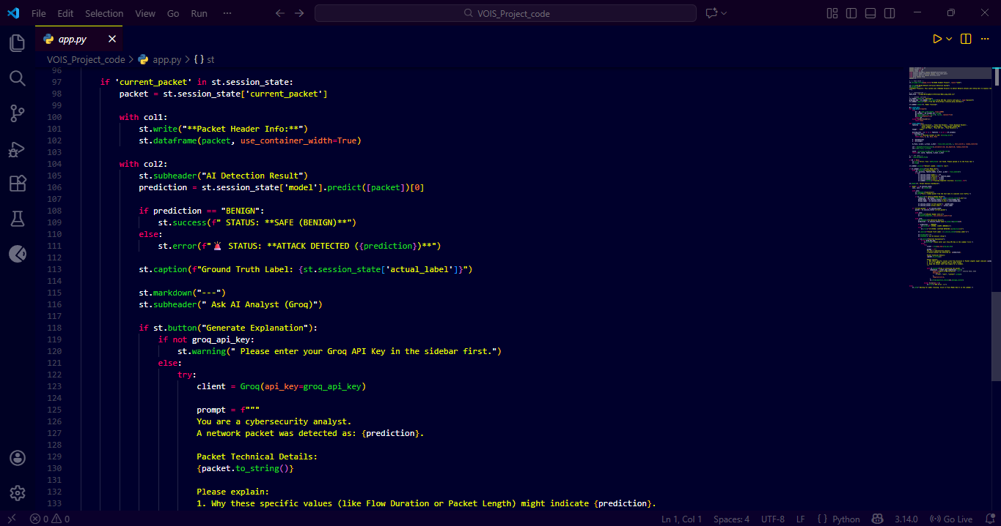
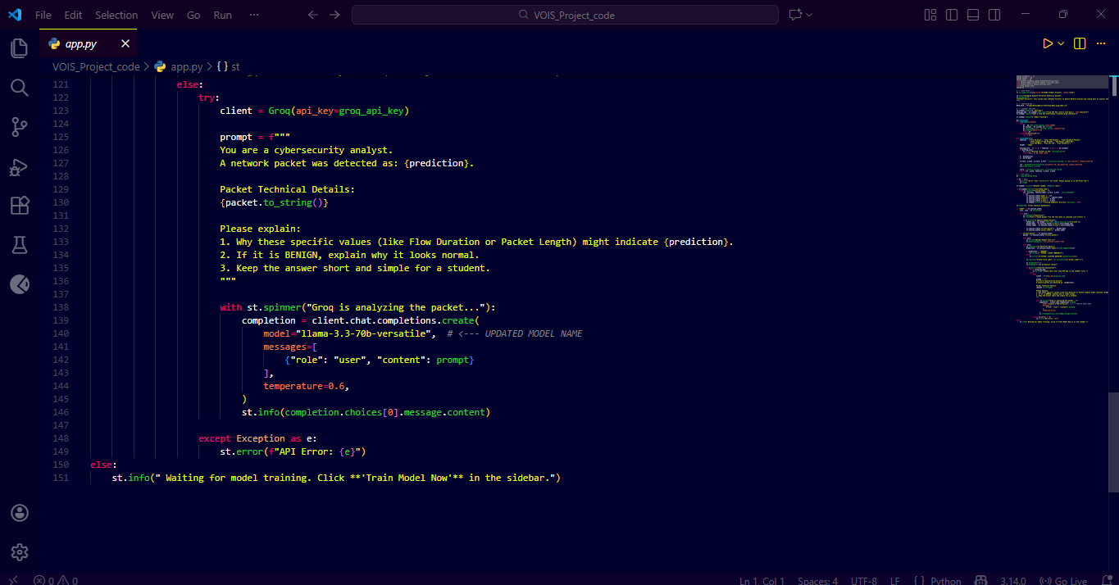
RESULTS
Demo Link

Slide 8

Certificate - Protection from browser attacks

Slide 9

Certificate - Introduction to System Security

Slide 10

Certificate - Securing Android Devices

Slide 11
GitHub link
https://github.com/Adarshh18/VOIS-AICTE-PROJECT.git

Slide 12
Thank you
.
.

